Slide 1

Customer Shopping Trends Analysis
-Abinaya B
RAGINI KATIYAR
SELSHIYA
VIDHI JAIN
Md. YASHIR

Slide 2
Data Preprocessing
1
§Data Collection:
The dataset has been collected from Kaggle.com
§Data Cleaning
Missing values and null values – The null and missing values were filtered out by using the filter option.
Duplicates were removed as well
§Data Integration
Merge or join datasets if customer information is spread across multiple sources.
Ensure all columns are consistent and relevant
§ Feature Engineering
Age group column – It is used to transform the age given in numerical values into categorical data.

Slide 3
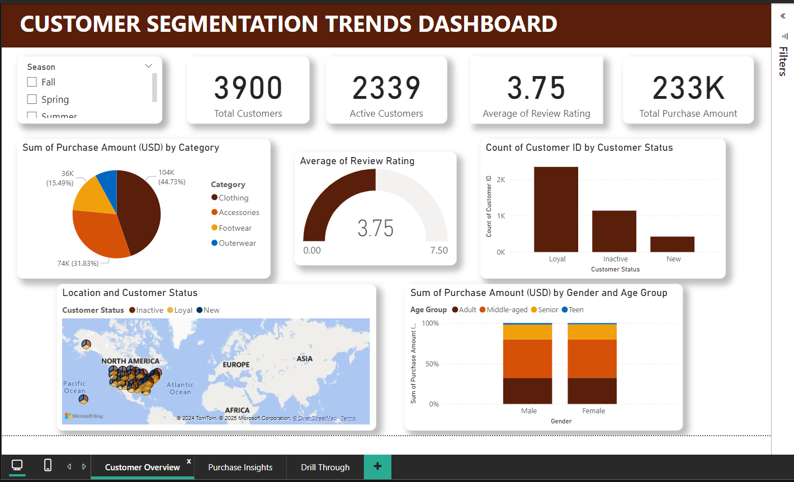
Dashboard
2
Customer Overview -Page 1

Slide 4
Visualizations
3
1. Key Performance Indicators (KPIs)
Cards:
Total Customers: Displays the total count of customers in the dataset.
Active Customers: Highlights the count of customers currently engaged with the business.
Average Review Rating: Shows the average rating provided by customers for products or services.
Total Purchase Amount: Summarizes the total revenue generated from customer purchases.
2. Filters
Slicer: Seasons
Provides the ability to filter the dashboard visuals by season (e.g., Spring, Summer, Fall, Winter).

Slide 5
Visualizations
4
3. Visuals for Insights
Pie Chart:
Purchase Amount by Category:
Displays the distribution of total purchase amounts across product or service categories, helping identify the most profitable segments.
Gauge Chart:
Review Rating:
A visual representation of the average review rating, indicating overall customer satisfaction.
Bar Chart:
Customer ID by Customer Status:
Shows the count of customers segmented by their status (e.g., Active, Inactive, Loyal), allowing deeper analysis of the customer base.

Slide 6
Visualizations
5
Stacked Bar Chart:
Gender and Age Group Split by Purchase Amount:
Analyzes purchase behavior across different gender and age demographics, highlighting spending patterns.
4. Geographical Insights
Map:
Customer Status (Inactive, Loyal, or New):
Provides a spatial view of customer status distribution, identifying regions with the highest concentration of loyal, new, or inactive customers.

Slide 7
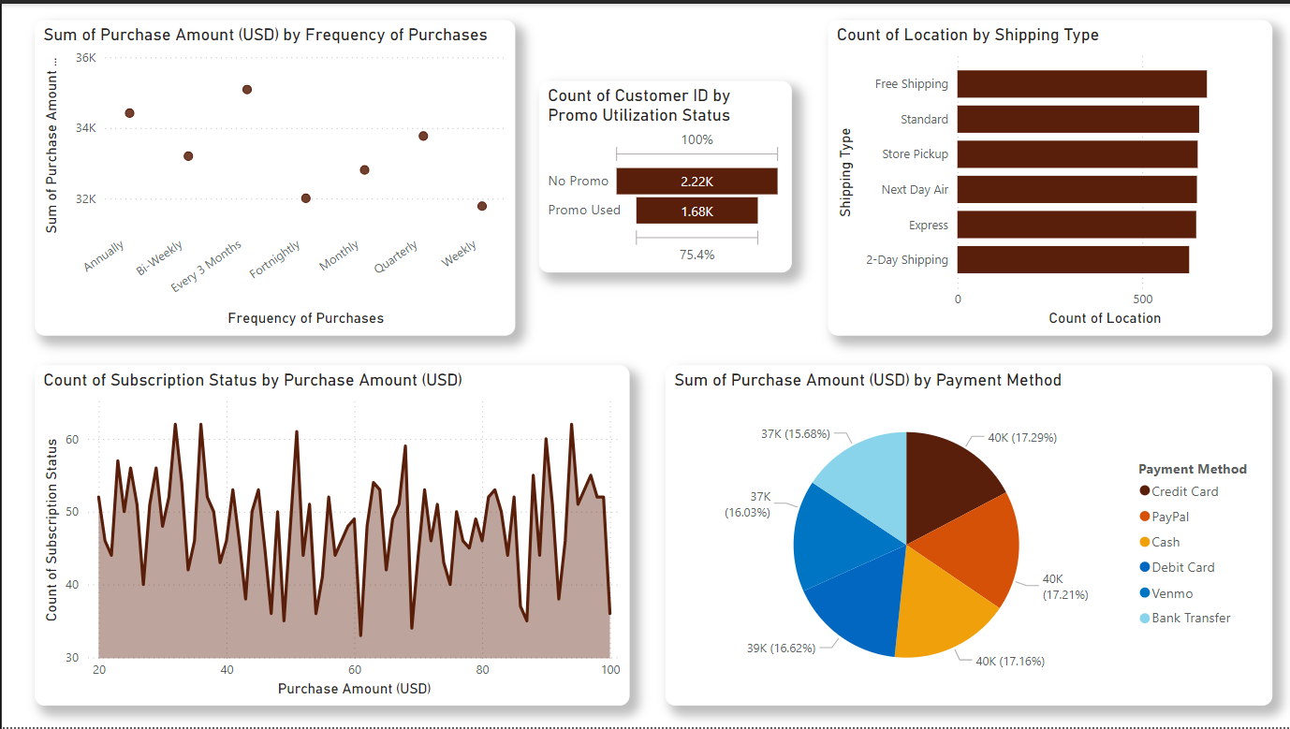
Dashboard
6
Purchase Insights- Page 2

Slide 8
Visualizations
7
1. Scatter Plot
Purchase Amount by Frequency of Purchases:
Visualizes the relationship between the total purchase amount and the number of purchases made by customers.
Helps identify trends, such as high-frequency, high-value customers or anomalies.
2. Funnel Chart
Customer ID by Promo Utilization Status:
Tracks the conversion of customers through different promo utilization stages (e.g., Received → Redeemed → Purchased).
Highlights the effectiveness of promotional campaigns.
3. Stacked Bar Chart
Location by Shipping Type:
Displays the distribution of shipping types (e.g., Standard, Express) across different locations.

Slide 9
Visualizations
8
Useful for analyzing shipping preferences and logistics planning.
Area Chart
Subscription Status by Purchase Amount:
Shows trends in purchase amounts for different subscription statuses (e.g., Subscribed, Unsubscribed, Trial).
Highlights the value generated by subscription-based customers over time.
5. Pie Chart
Purchase Amount by Payment Method:
Breaks down total purchase amounts by payment methods (e.g., Credit Card, PayPal, Cash).
Helps identify the most popular payment options among customers.

Slide 10
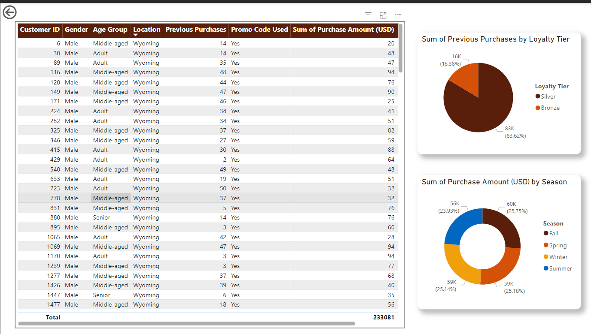
Dashboard
9
Drill Through - Page 3

Slide 11
Visualizations
10
1. Table
Customer Overview:
Columns:
Customer ID, Gender, Age Group, Location, Previous Purchases,Promo Code Utilization, Purchase Amount ,Review Rating
2. Pie Chart
Previous Purchases by Loyalty Tier:
Segments the number of previous purchases across different loyalty tiers (e.g., Bronze, Silver, Gold).
Highlights customer engagement levels within each tier.

Slide 12
Visualizations
11
3. Donut Chart
Purchase Amount by Season:
Visualizes the total purchase amount split by seasons (e.g., Spring, Summer, Fall, Winter).
Useful for identifying peak sales periods and seasonal trends.

Slide 13
Thank You

